Slide 1












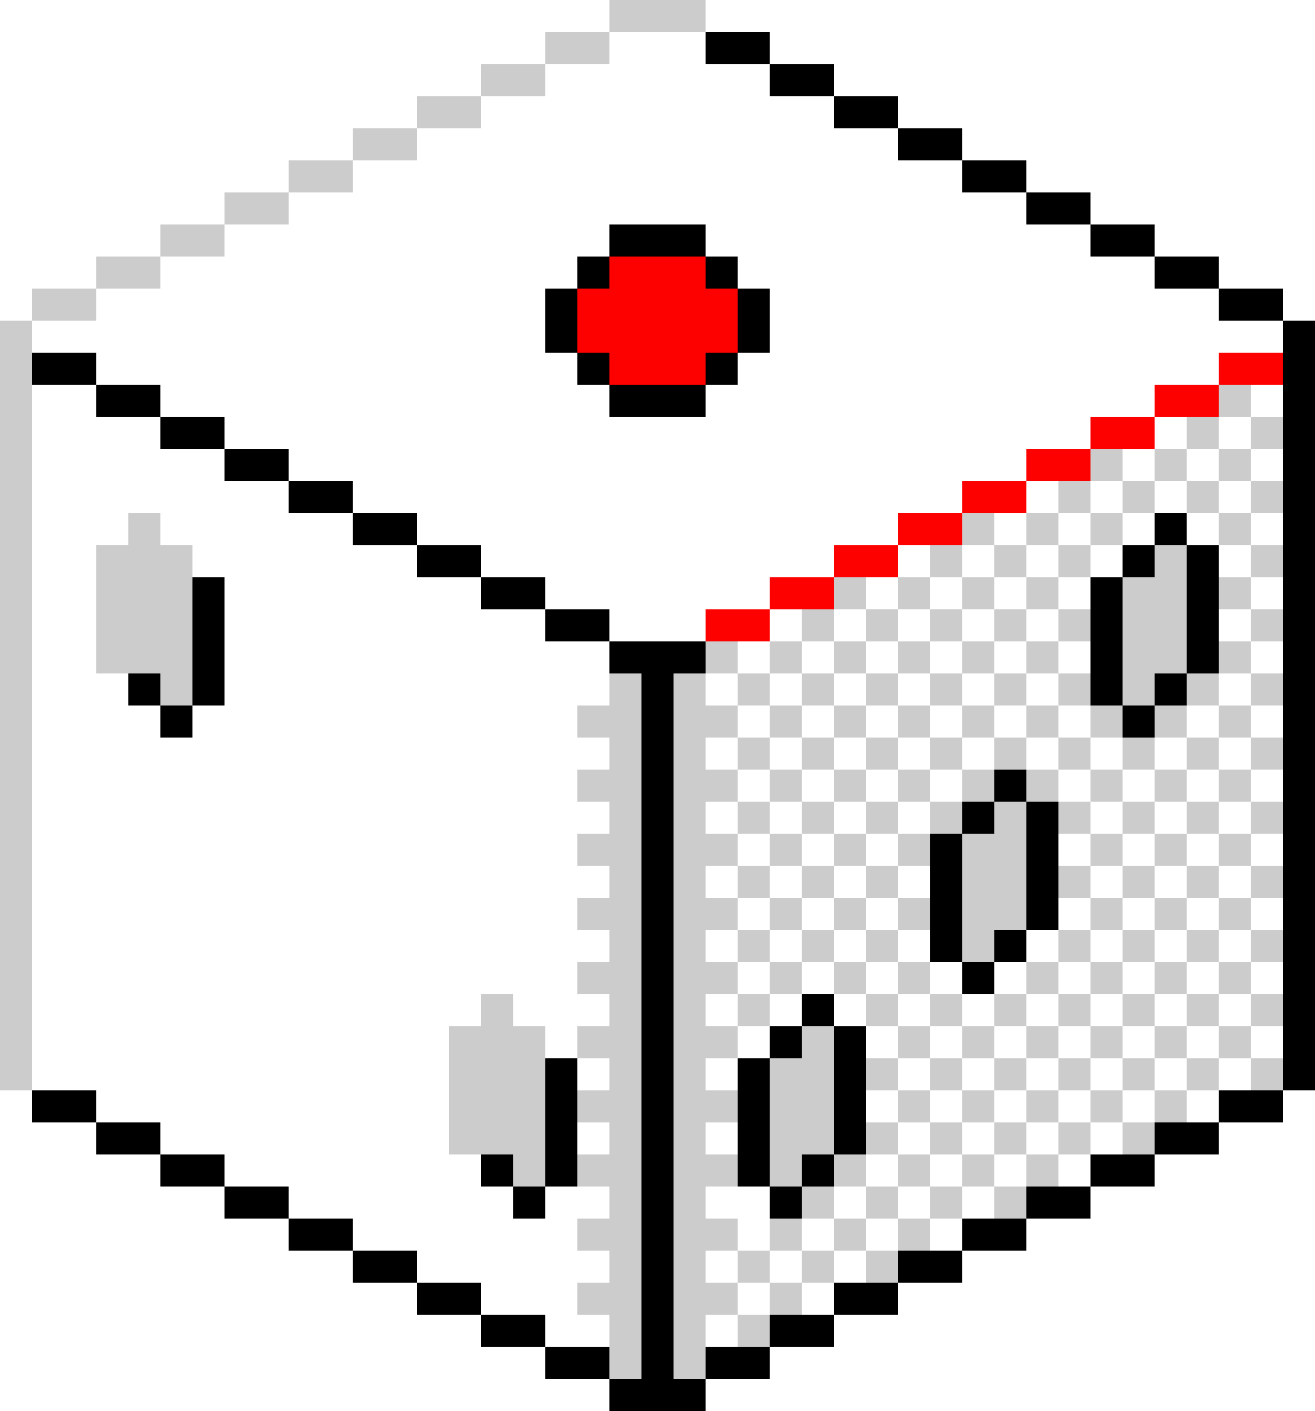



Falling Detection System
Algorithms, Techniques and Dataset
Malak AlKazem - Ali Ossaily
11:11AM

Slide 2
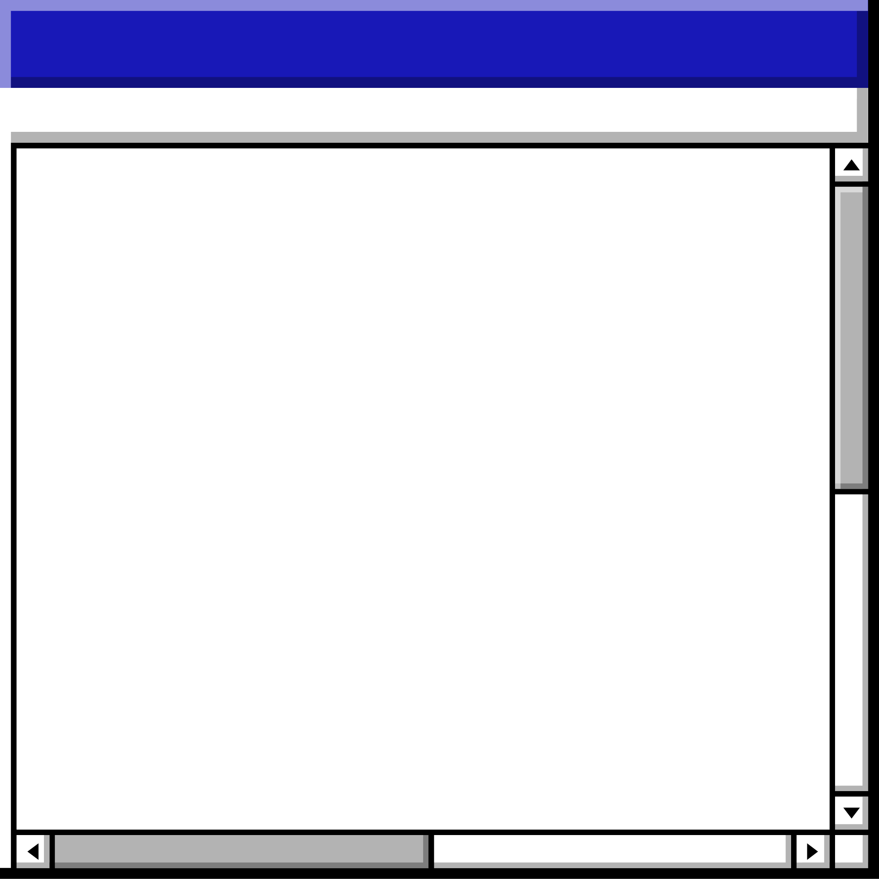
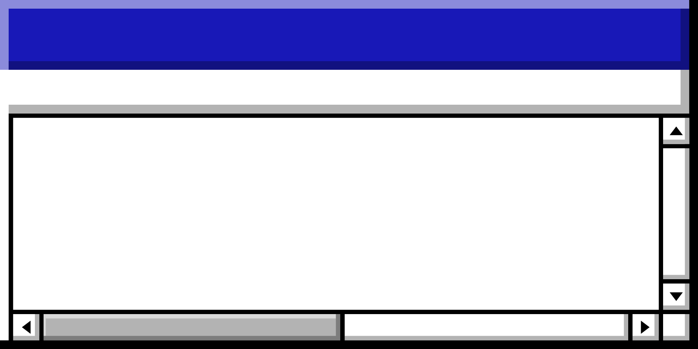

Agenda • Agenda • Agenda • Agenda • Agenda • Agenda • Agenda • Agenda • Agenda • Agenda • Agenda • Agenda • Agenda • Agenda
Topics Covered
YOLO, which stands for "You Only Look Once", is a popular algorithm for object detection in computer vision. It's known for its speed and efficiency, making it ideal for real-time applications.\
Single-Shot Detection: Unlike some object detection methods that require multiple passes through an image, YOLO takes a single shot. It uses a convolutional neural network (CNN) to analyze the entire image in one go.
YOLO

Slide 3
Important Features
Bounding Boxes and Class Probabilities: YOLO divides the image into a grid. For each grid cell, it predicts two things:
Bounding boxes: These boxes highlight the location and size of potential objects within the cell.
Class probabilities: YOLO assigns a probability score to each class of object (e.g., car, cat, person) for each bounding box. This indicates how likely it is that the box contains that specific object.
11:11AM

Slide 4
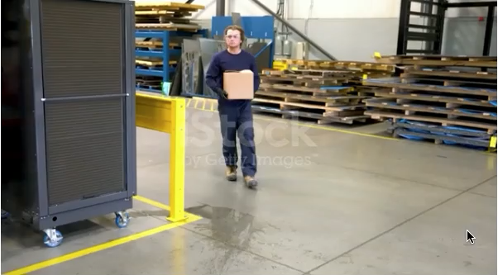
11:11AM

Slide 5
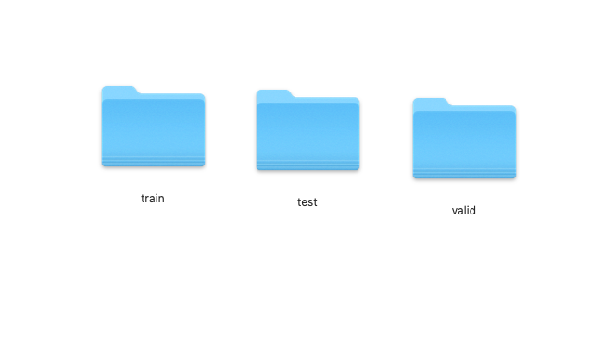
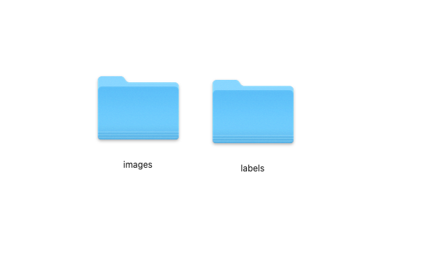
Dataset
Collection: We collected a dataset of over 2000 images of people in falling motion.
Annotation: We used roboflows annotation tool to annotate the images.
File structure:
train
test
valid
images
labels
11:11AM

Slide 6
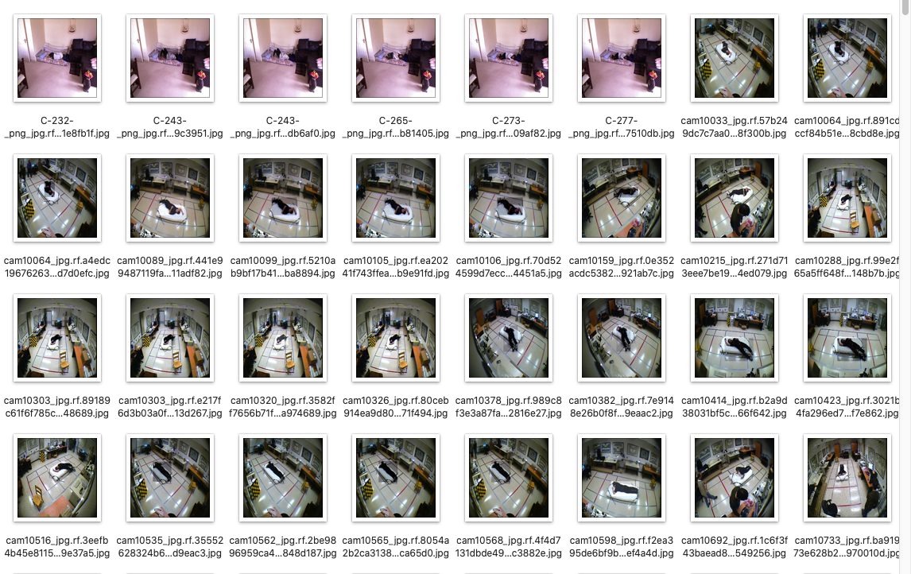
11:11AM

Slide 7
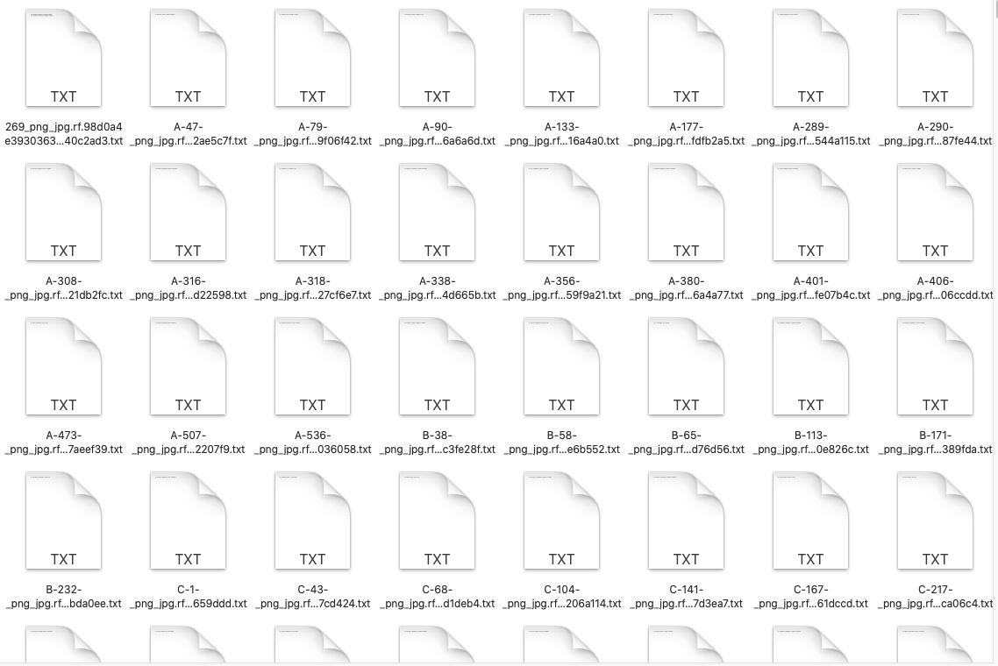
11:11AM

Slide 8



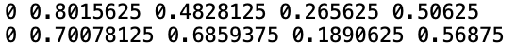












Section Header • Section Header • Section Header • Section Header • Section Header • Section Header • Section Header • Section Header
Labels
Section Header • Section Header • Section Header • Section Header • Section Header • Section Header • Section Header • Section Header

Slide 9
Inference
To make our model work on all devices even on less powerful ones, we decided to use inference for cloud computing.
We used the model we trained on Roboflow to make api calls on the images, that are ultimately frames of the video being captured live on the webcam.
11:11AM

Slide 10
openCV
We utilized OpenCV to capture the live webcam feed. This library provides efficient tools for video capture. OpenCV then divides the continuous video stream into individual frames, creating a sequence of images. These frames can be sent to Roboflow's API for further processing. Roboflow's API likely leverages its inference engine to analyze each frame using your trained computer vision model.
11:11AM

Slide 11
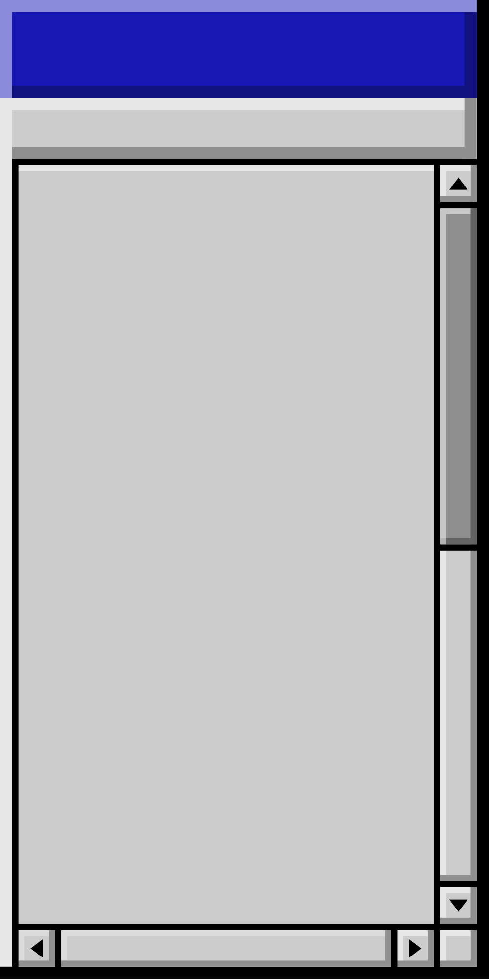
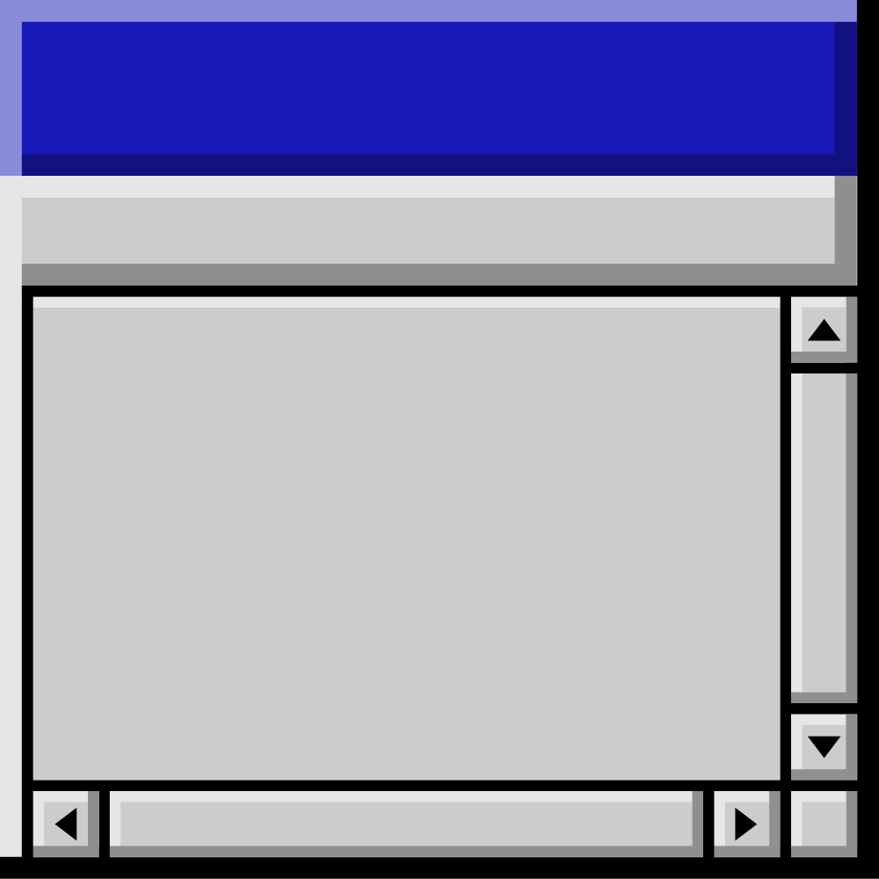
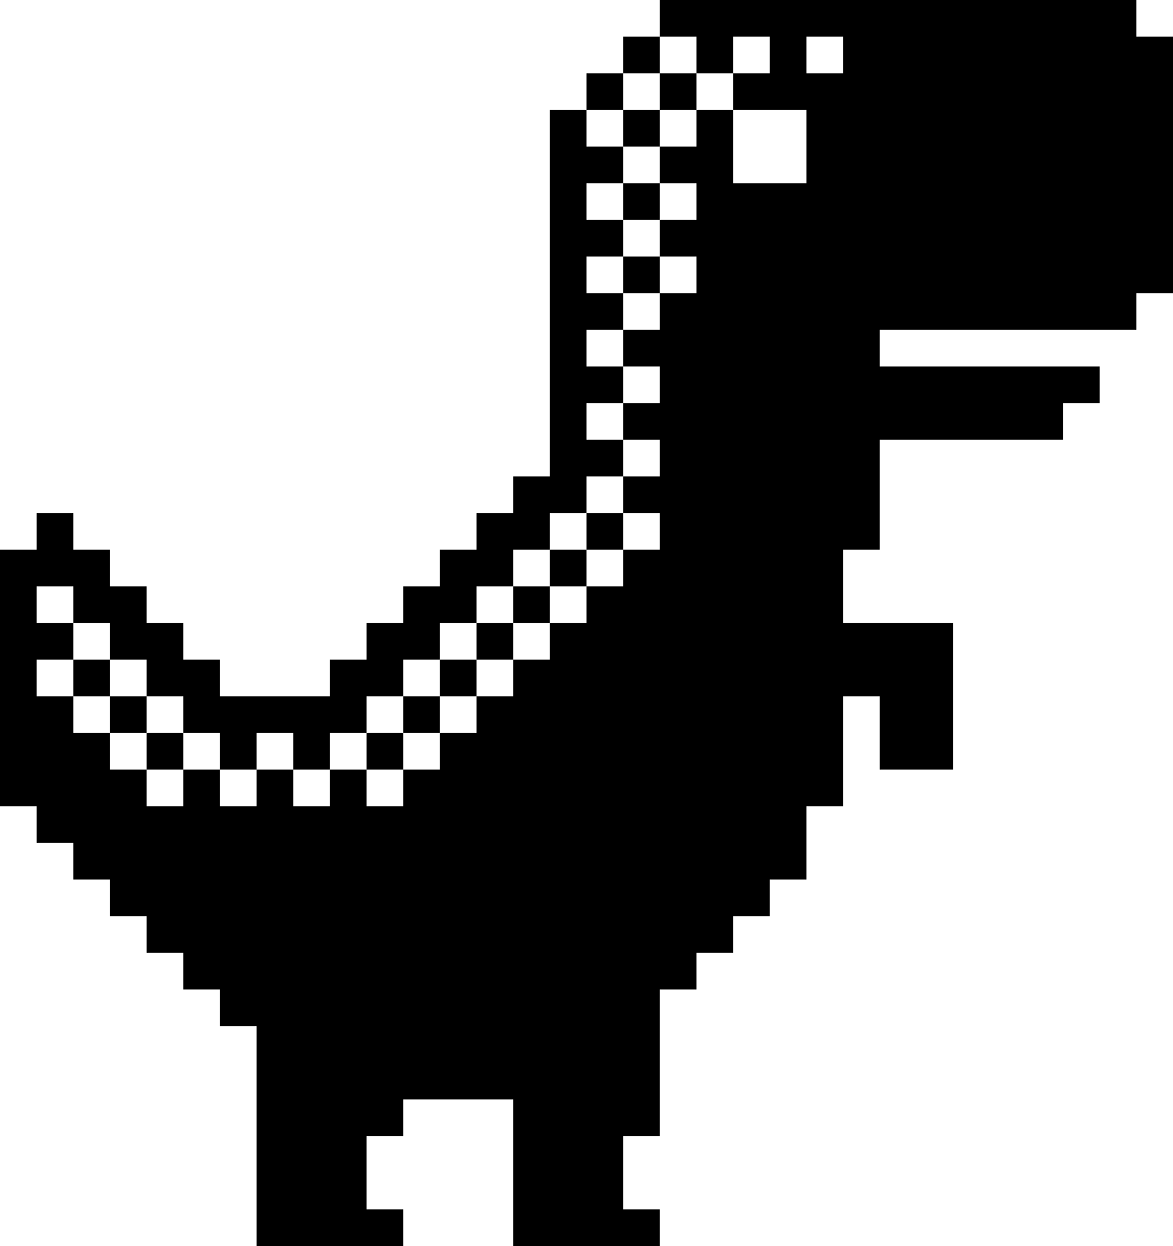
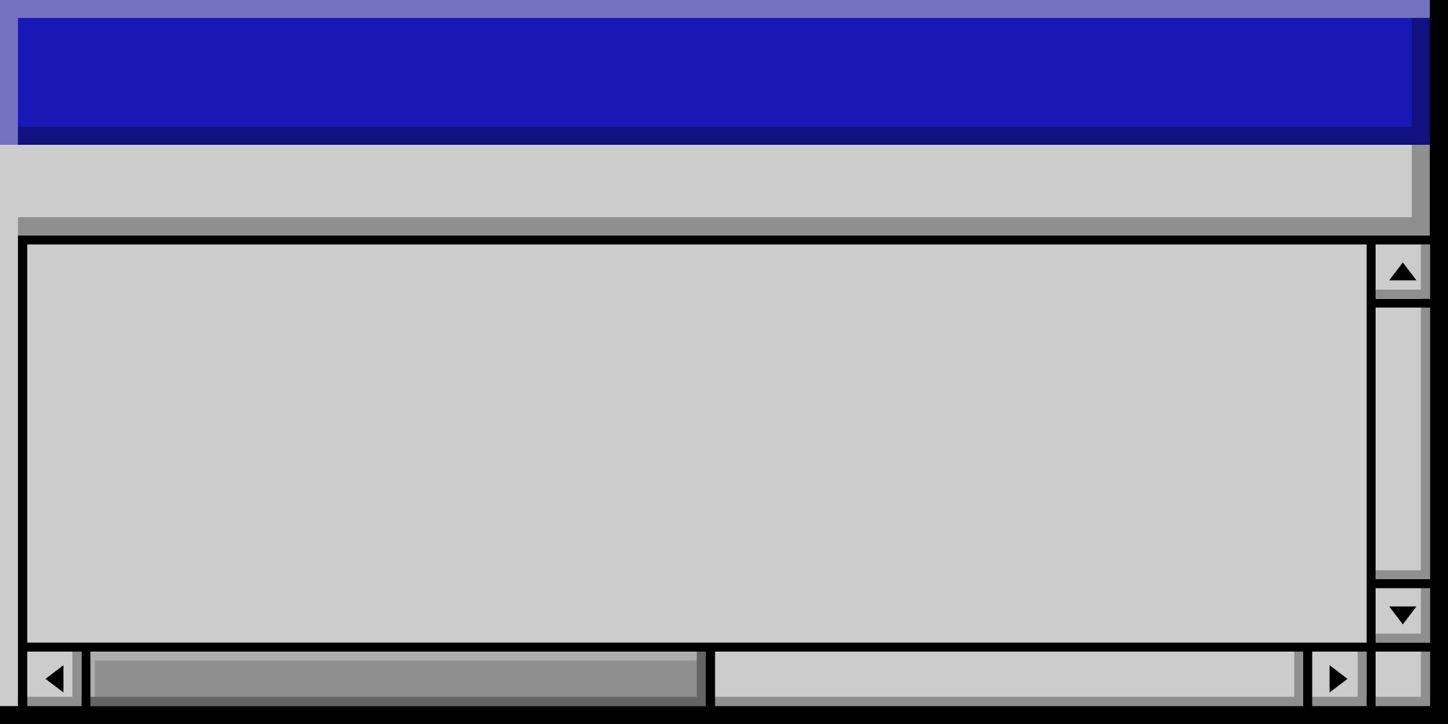
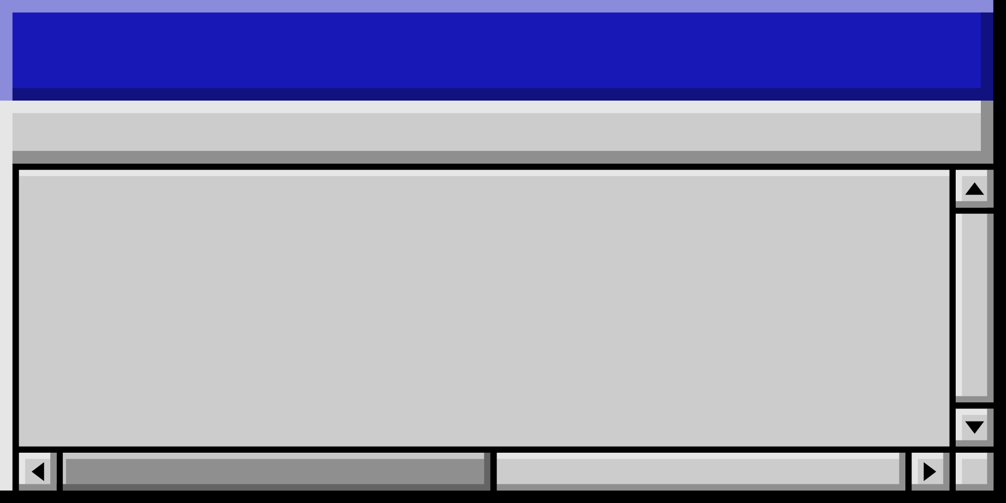

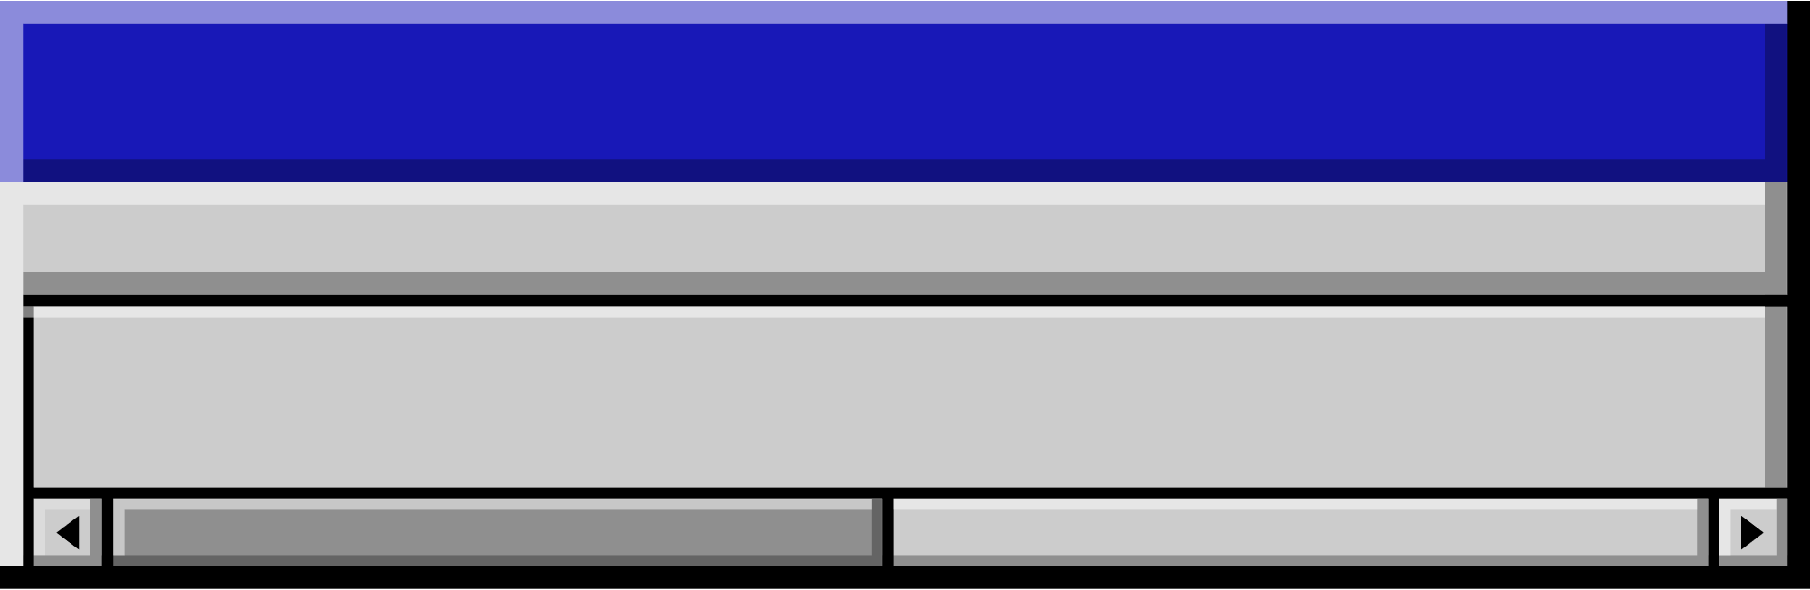
Part 2:
Integration between python Model and android App

Slide 12
Agenda • Agenda • Agenda • Agenda • Agenda • Agenda • Agenda • Agenda • Agenda • Agenda • Agenda • Agenda • Agenda • Agenda
Topics Covered
Firebase Cloud Messaging (FCM) is a cross-platform messaging solution developed by Google. It enables developers to send notifications and messages to users on various platforms, including Android, iOS, and web browsers.
To integrate Firebase Cloud Messaging (FCM) into both a Python project and a Java mobile app, you'll need to follow these general steps:
FCM

Slide 13
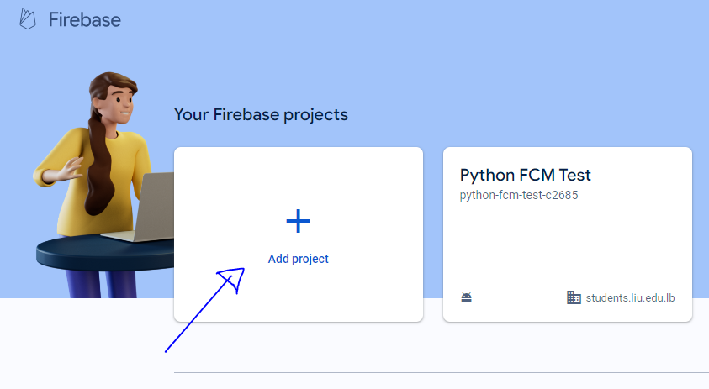
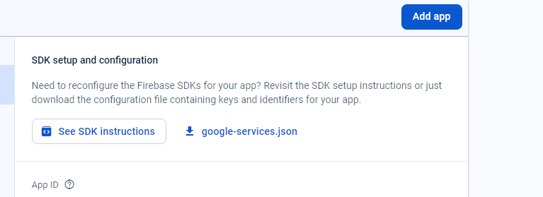
Set up Firebase Project
Create a Firebase project on the Firebase console (https://console.firebase.google.com/).
Add your Android app to the project and download the google-services.json file.
Add your Python project to the Firebase project and obtain the necessary credentials for authentication
11:11AM

Slide 14
Integrate FCM in Android App (Java)
Add the Firebase SDK to your Android app by adding the google-services.json file to your project.
Set up Firebase Cloud Messaging in your Android app by configuring FirebaseMessagingService and FirebaseInstanceIDService.
11:11AM

Slide 15
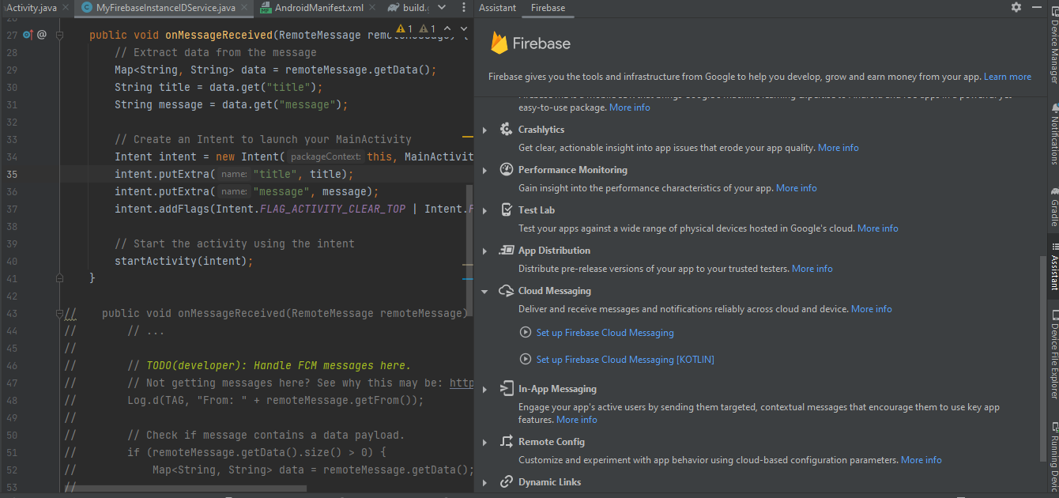
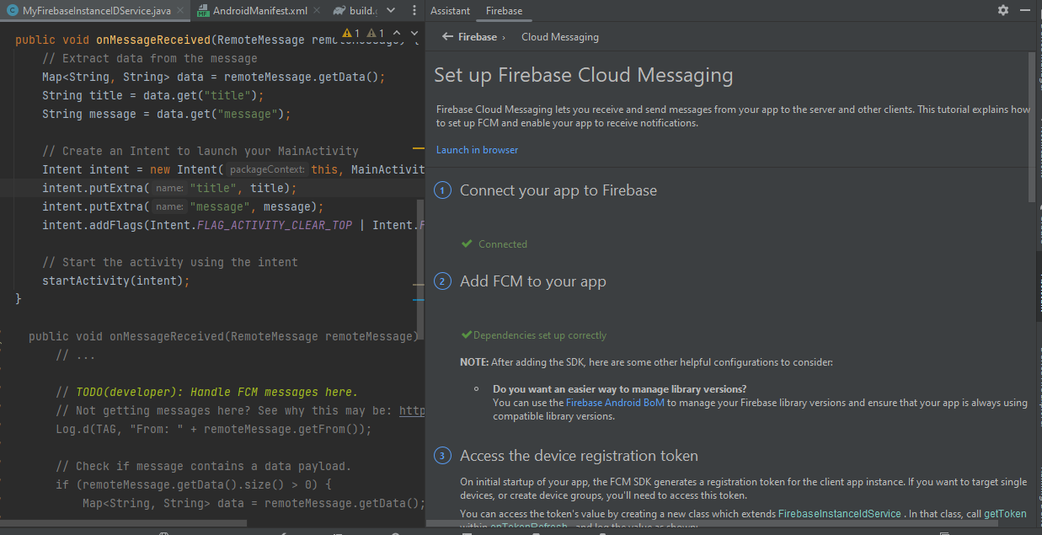
11:11AM

Slide 16
Integrate FCM in Python:
Use the Firebase Admin SDK for Python to send messages from your Python backend to the FCM server.
Authenticate your Python server with Firebase using the credentials obtained from the Firebase console.
Implement code in your Python project to send messages to specific devices or topics using the FCM API
Testing:
Test sending messages from your Python backend to your Android app using FCM
11:11AM

Slide 17
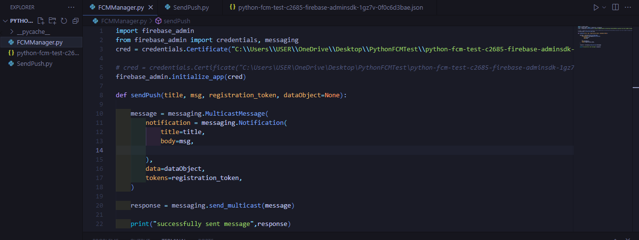
11:11AM

Slide 18
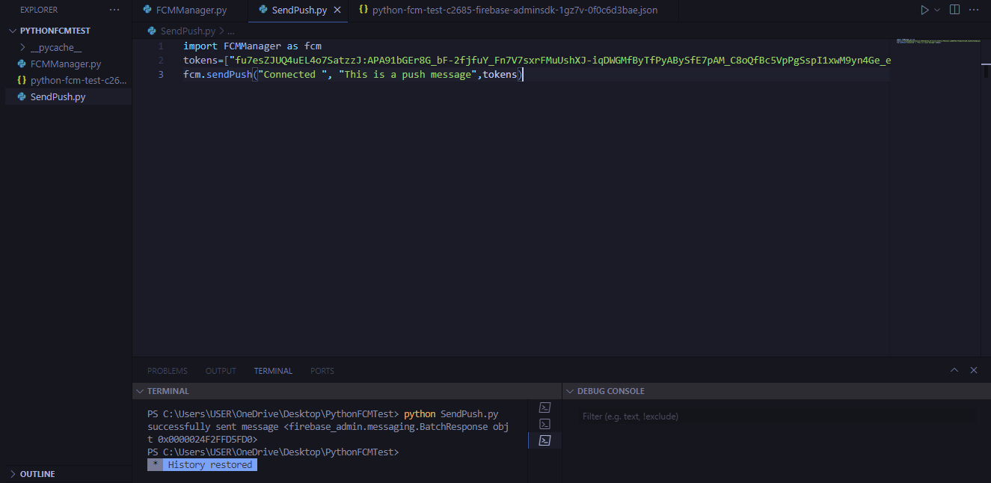

11:11AM

Slide 19
Citations
https://github.com/ultralytics/ultralytics
https://roboflow.com/
https://docs.opencv.org/4.x/index.html
https://docs.inferencesolutions.com/api/
https://console.firebase.google.com/

Slide 20
Thank you!
☺

